Slide 1
Introduction toToxy
A .NET based open source
text/data extraction framework

Slide 2
What’s Toxy
It’s a framework based on .NET
It can identify the file formats based on extension (content-type in future version)
It can extract the text or structured data from the file formats
It provides unified structures for different use case

Slide 3
Why use Toxy
IFilter can also extract data but is not a cross-platform solution
It supports many file formats
It’s based on pure .NET third-party components
Performance is much better than COM-based solution
Unified structures make data-handling really easy
Easy to learn and use.
Apache 2.0 license – free for commercial use

Slide 4
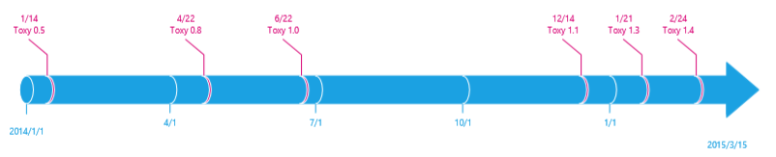
Releases

Slide 5
Supported file formats
PDF, Word (.doc and .docx)
Excel (.xls and .xlsx), CSV
Audio formats such as .wav, .mp3 and so on
Image formats such as .jpg, .png, .gif and so on
Business cards format (.vcf)
Email archive (.eml and .cnm)
PowerPoint (.pptx)
… (More in the future)

Slide 6


















Toxy Framework

Slide 7
Toxy Unified Structures
ToxyDocument is designed for documents such as Word, PDF
ToxySpreadsheet is designed for spreadsheets such as Excel and CSV
ToxyEmail is designed for email formats.
ToxyBusinessCard is designed for business card format (vcf).
ToxyDom is designed for DOM-basd formats such as HTML and XML
ToxyMetadata is designed for any files containing meta information (Since Toxy 1.3)

Slide 8
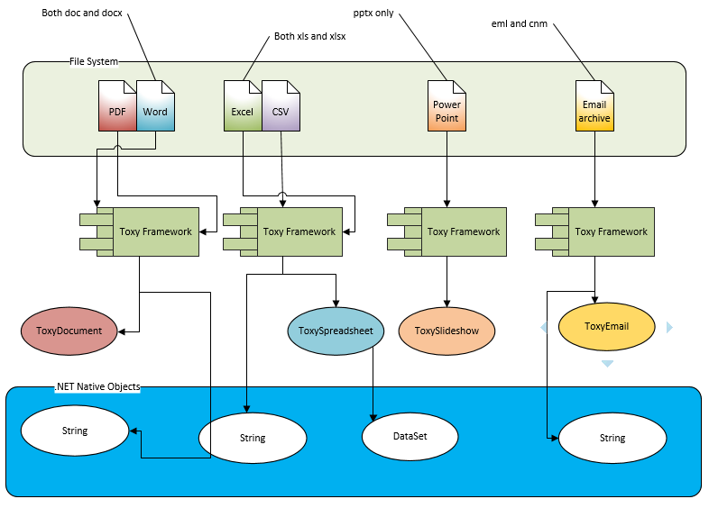
Data extraction process via Toxy

Slide 9
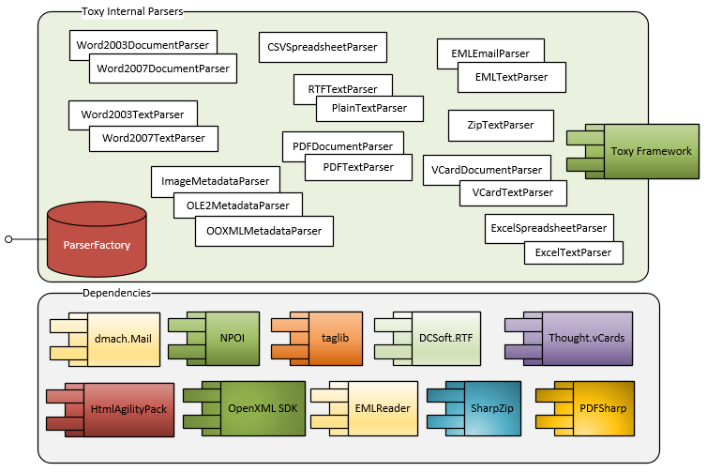
Dependencies
Internal parsers are transparent from Toxy Users

Slide 10
Use case - Lucene indexing
Before
Now

Slide 11
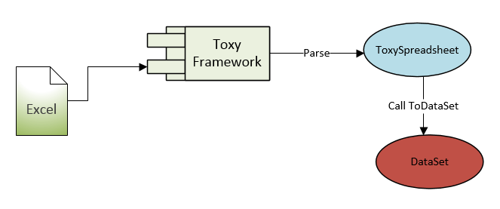
Use case –Excel to Dataset

Slide 12
Roadmap
Supports more formats such as msg, mht, StarOffice formats, OpenOffice formats, WPS formats and so on
file type identification via content-type or streaming
Convert text to vector for NLP/research purpose
Automatic language identification

Slide 13
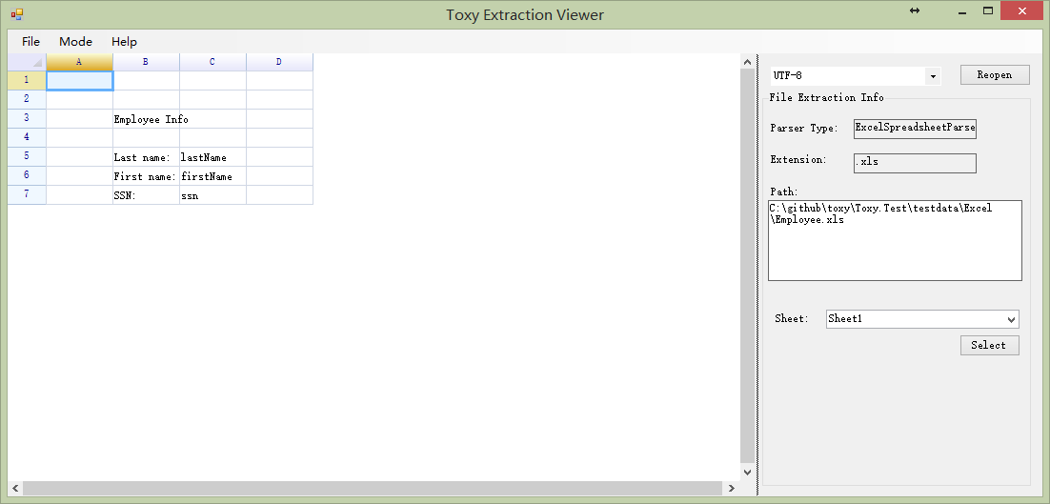
Tool: Toxy Extraction Viewer
Source code location: <toxy folder>\Toxy.Tools\ExtractionViewer

Slide 14
Toxy on Internet
Neuzilla – the studio behind Toxy
http://www.neuzilla.com/blog
Codeplex website: http://toxy.codeplex.com
Github website: https://github.com/tonyqus/toxy
QQ Group: 297128022

